Slide 1


Zeal Education Society’s Zeal College of Engineering & ResearchNarhe,Pune-411041. Department of Information Technology Academic Year (2019-20) Class: BE Project Phase-II
Project Title “Student Attendance System Via Face Recognition using Python”
Group Member Names:
Akshay Jadhav (71831385C)
Shubham Bankar (71831131M)
Atharva Tillu (71739727M)
Mayur Dawande(71831629M)
Guide:
Prof. Supriya Patil

Slide 2
Contents
1. Introduction
2. Objective
3. Motivation
4. Literature Survey
5. Problem statement
6. System Architecture and High Level Design
7. S/W n H/W Required
8. Algorithm
9.Test Cases
10.System Screenshots
11.Conclusion
12.Publication Details
13.References

Slide 3
1. Purpose
The main purpose of this project is to build a face recognition-based attendance monitoring system for educational institution to enhance and upgrade the current attendance system into more efficient and effective as compared to before.
The current old system has a lot of ambiguity that caused inaccurate and inefficient of attendance taking.
Many problems arise when the authority is unable to enforce the regulation that exist in the old system.
Thus, by means of technology, this project will resolve the flaws existed in the current system while bringing attendance taking to a whole new level by automating most of the tasks. The technology working behind will be the face recognition system.

Slide 4
2. Objective
The main objective of this project is to develop face recognition based automated student attendance system.
In order to achieve better performance, the test images and training images of this proposed approach are limited to frontal and upright facial images.
The test images and training images have to be captured by using the same device to ensure no quality difference.
In addition, the student have to register in the database to be recognized. The enrollment can be done on the spot through the user-friendly interface.

Slide 5
3. Motivation
Loss of time of Teachers and Students for taking Attendance by traditional Paper Method.
Proxy Attendance markings by students
Inconvenience when sometimes the Attendance Registers may get lost.

Slide 6
4. Literature Survey
Sr. No.​ | Face detection method ​ | Advantages​ | Limitations​
1.​ | Local Binary pattern ​ | High tolerance against the monotonic illumination changes. ​ | Overall performance is accurate.​
2.​ | AdaBoost algorithm ​ (part of Viola jones algorithm) ​ | Need not to have any prior knowledge about face structure. ​ | The result highly depends on the training data and affected by weak classifiers. ​ ​
3.​ | Neural-Network ​ ​ | High accuracy only if large size of image were trained. ​ ​ | Overall performance is weaker than LBPH algorithm. ​ ​

Slide 7
5. Problem Statement
Traditional student attendance marking technique is often facing a lot of trouble.
Our system emphasizes its simplicity by eliminating classical student attendance marking technique such as marking attendance on paper.
There causes distraction for students during exam sessions and there are human errors many times.
The lecture class especially the class with a large number of students might find it difficult to have the attendance sheet being passed around the class .
Thus, face recognition student attendance system is proposed in order to replace the manual signing of the presence of students.
Furthermore, the face recognition based automated student attendance system able to overcome the problem of fraudulent approach.

Slide 8
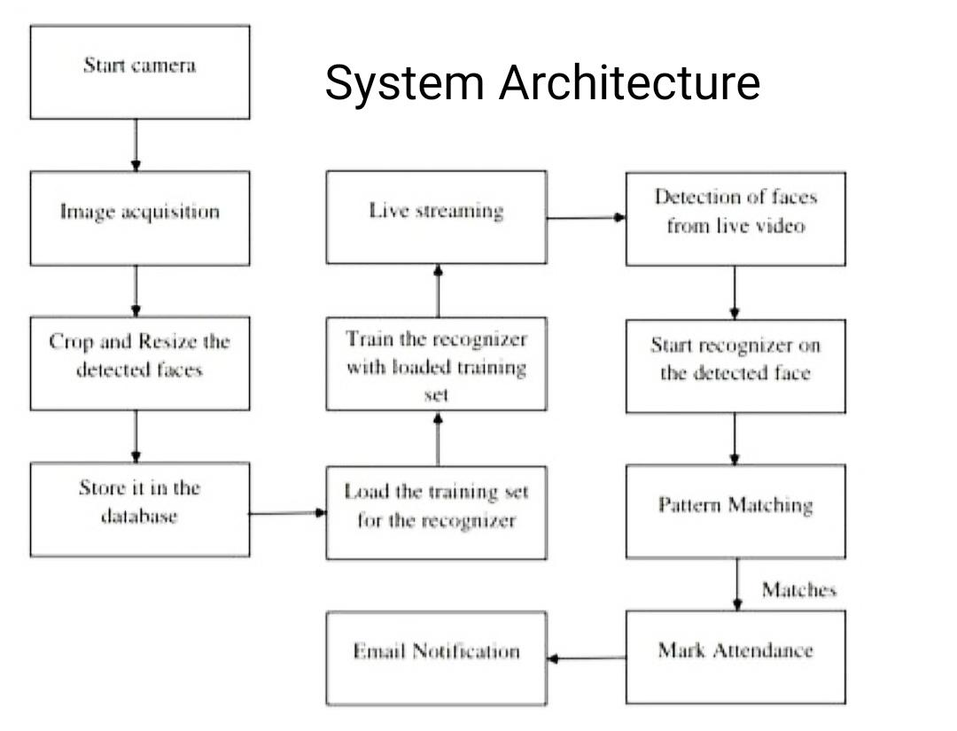
6. System Architecture and High Level Design

Slide 9
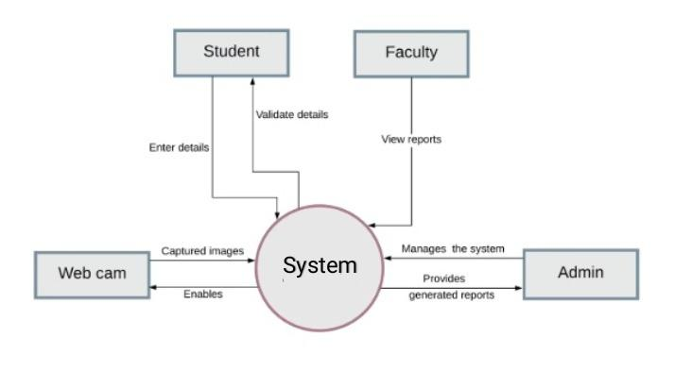
7. DFD Diagram
DFD: Context Level

Slide 10
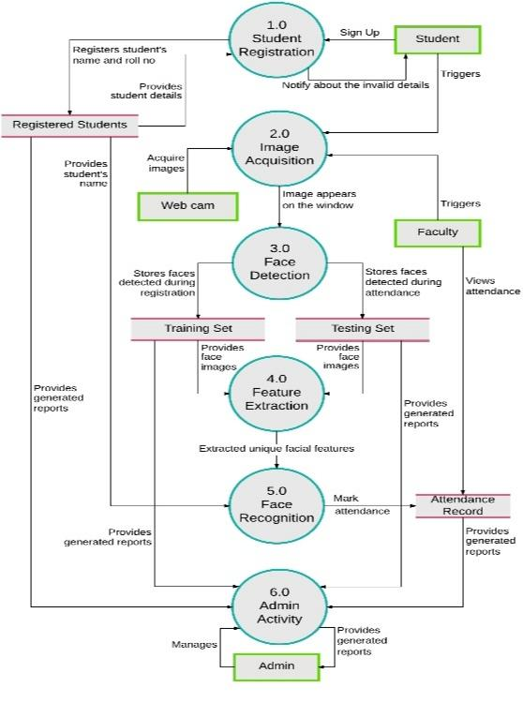
DFD : Level 0

Slide 11
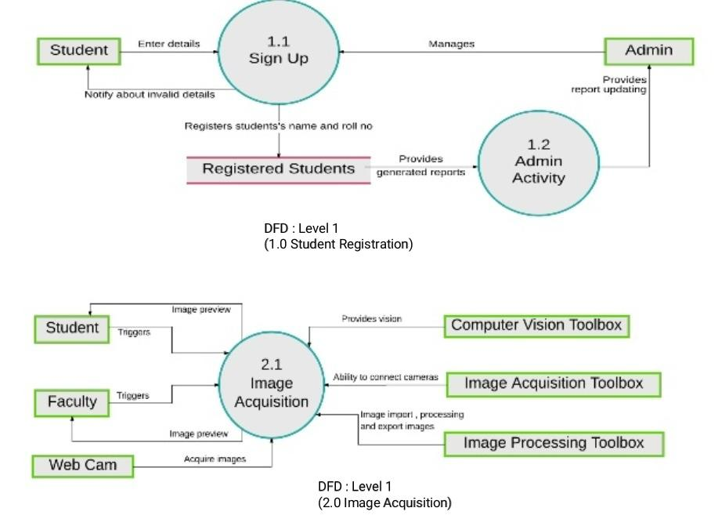
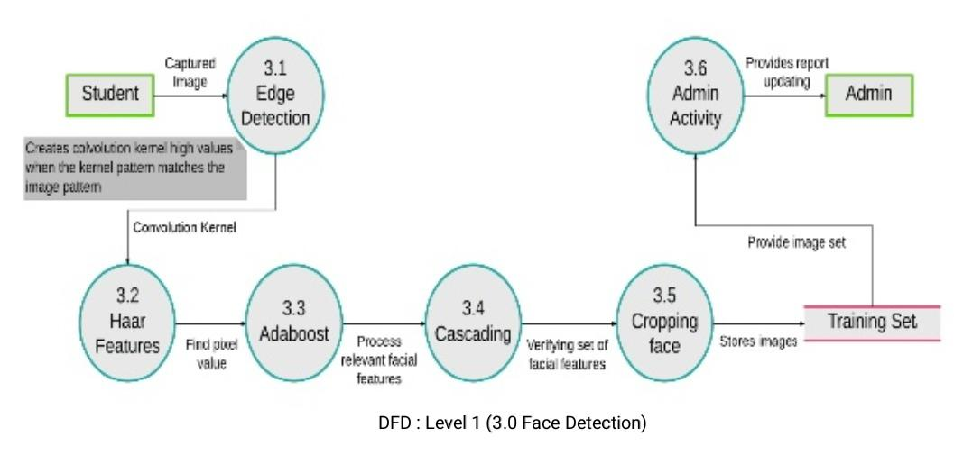

Slide 12
8. S/W & H/W Requirements
HARDWARE REQUIREMENTS:-
RAM : More than 2 GB
Processor : I5 or Above
HDD : 1TB or Above
Camera
SOFTWARE REQUIREMENTS:-
Back End : SQLite
Front End : Python
Python IDLE
OS : Windows 7/8/10

Slide 13
9. Methodology
Haar Cascade Classifier It is an Object Detection Algorithm used to identify faces in an image or a real time video.
The algorithm uses edge or line detection features for detecting objects.
The Haar feature continuously traverses from the top left of the image to the bottom right to search for the particular feature.
In its actual work, the haar feature would traverse pixel by pixel in the image.
The repository has the models stored in XML files, and can be read with the OpenCV methods.
These include models for face detection, eye detection, upper body and lower body detection, etc.

Slide 14
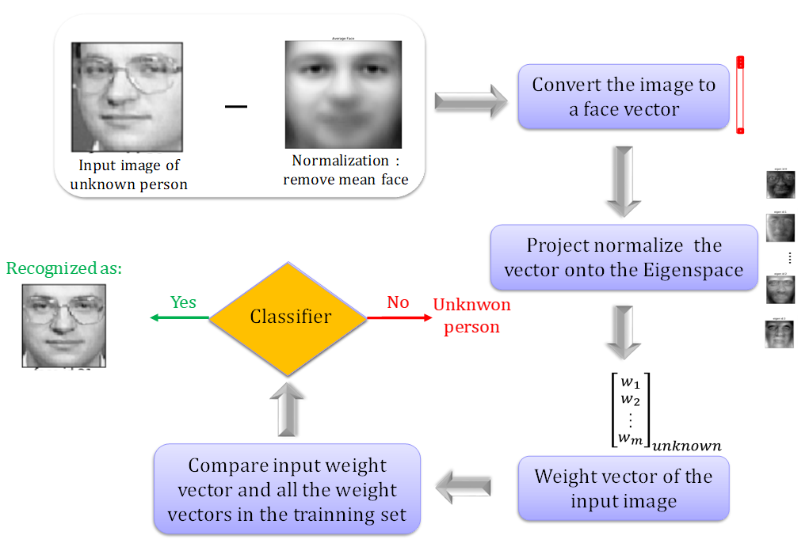
10. Algorithm Convolutional neural network
In a CNN, the input is a tensor with a shape: (number of inputs) x (input height) x (input width) x (input channels).
After passing through a convolutional layer, the image becomes abstracted to a feature map, also called an activation map, with shape: (number of inputs) x (feature map height) x (feature map width) x (feature map channels).

Slide 15

11. System Screenshots
Home Page

Slide 16


Admin SignUp
Student SignUp

Slide 17
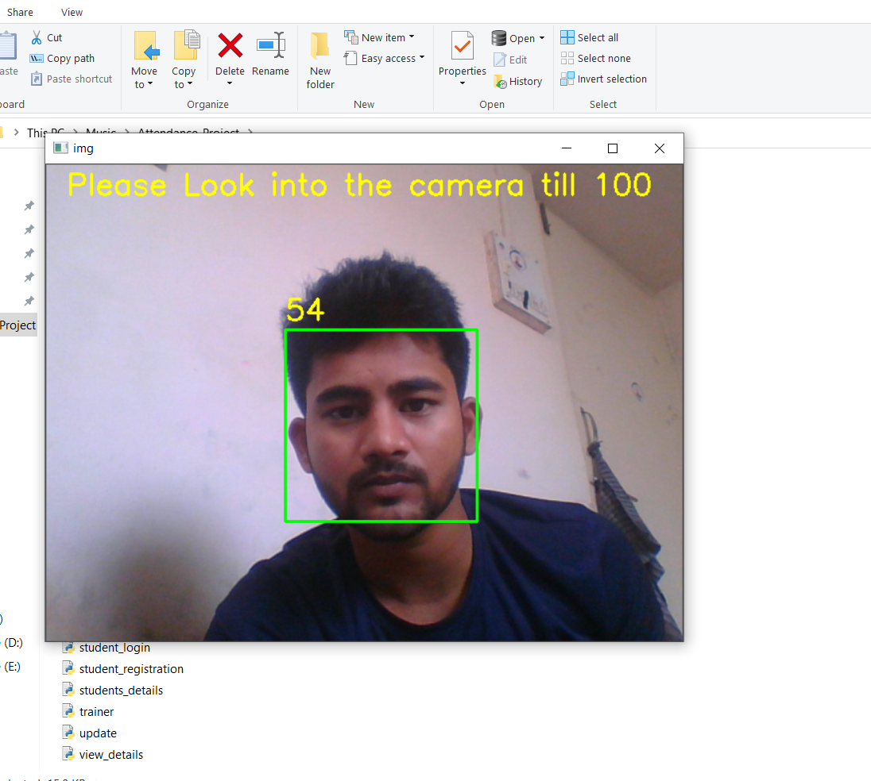
Facial Data Training

Slide 18
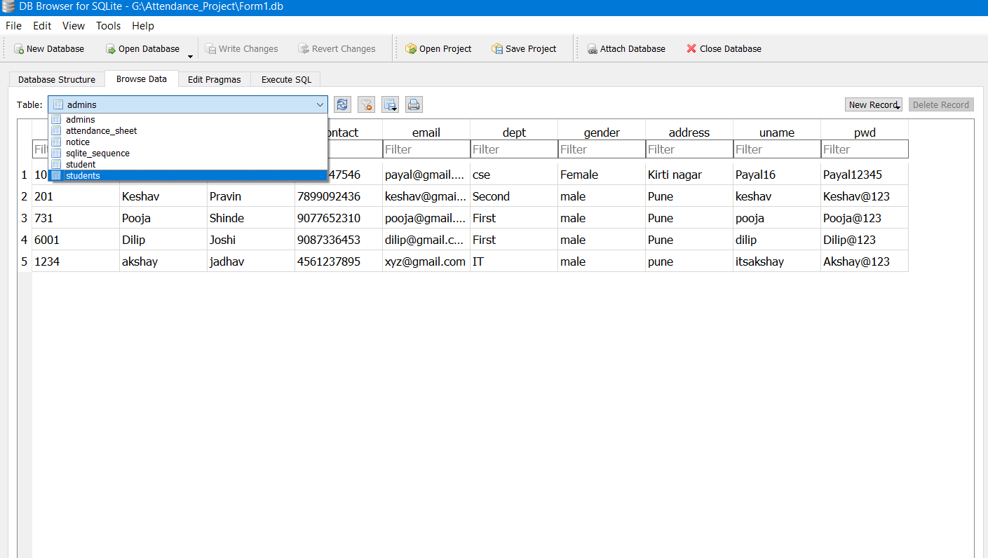
Database :

Slide 19
12. Conclusion
This project is undertaken to design a system which can identify threats using TensorFlow.
The proposed system can recognize weapons and people which wish to cause harm to society.
The proposed system is able to recognize both static/dynamic objects which can be harmful and reports them to respective person in-charge.
The method works in real time which will be useful in detection and reduction of security threats.

Slide 20
13. Publication Details
Sr. No. | Title of the paper | Conference/ Journal | Place if Conference
1. | Online Student Attendance System via Face Recognition using Python | JETIR2104052 | NA
2. | Online Student Attendance System via Face Recognition using Haar Cascade Classifier | JETIR2104103 | NA

Slide 21
14. References
Attendance System Using Face Recognition and Class Monitoring System, Arun Katara1, Mr. Sudesh2 V.Kolhe3http://www.ijritcc.org/download/browse/Volume_ 5_Issues/February_17_Volume_5_Issue_2/1489565866_ 15- 03-2017.pdf
G. Yang and T. S. Huang, “Human face detection in complex background,” Pattern Recognition Letter, vol. 27, no.1, pp. 53-63, 1994.
C. Kotropoulos and I. Pitas, “Rule-based face detection in frontal views,” Proc. Int’l Conf. Acoustics, Speech and Signal Processing, vol. 4, pp. 2537-2540, 1997.
Xinjun Ma, Hongqiao Zhang, XinZang, “A face detection algorithm based on modified skin-color model”, CCC, vol. 1, pp. 3896-3900, IEEE, 2013 [7] V. Shehu and A. Dika, “Using Real Time Computer Algorithms in Automatic Attendance Management Systems.” IEEE, pp. 397 – 402, Jun. 2010.

Slide 22
Thank You

